Slide 1
Covid 19 Layoffs Data Analysis (2020-2023)
By Team BigBlues
Shaik Aamina
Sahiti Keesari
Nuzat Siddiqua
Parisha Rathod

Slide 2

Problem Statement
Analyze the impact of the COVID-19 pandemic on global employment by examining trends in layoffs across industries, countries, and time periods. Identify the most affected industries and regions and explore potential factors contributing to the job losses. Develop insights for policymakers and business leaders to mitigate the economic impact of future pandemics and crises

Slide 3
Data Set Insights
The nature of the dataset is a time series dataset containing information on layoffs due to the COVID-19 pandemic
It is a structured dataset that can be analyzed using various statistical and visualization techniques.

Slide 4
Data Cleaning
1.Handling missing or null values: Check for missing values in the dataset and decide how to handle them. You can either drop the rows with missing values or fill them with appropriate values.
2.Handling duplicates: Check for any duplicate rows in the dataset and remove them if necessary.
3.Handling inconsistent values: Check for any inconsistent or erroneous values in the dataset and fix them if needed.

Slide 5
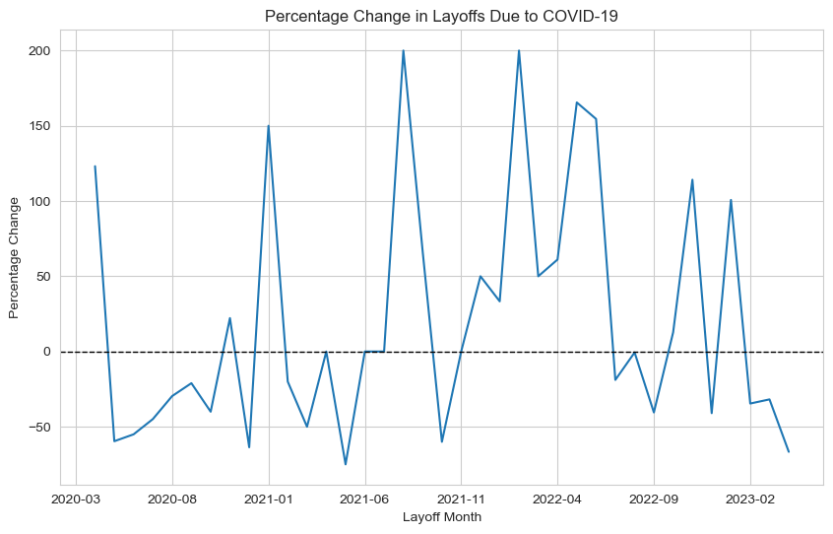
Graph 1

Slide 6
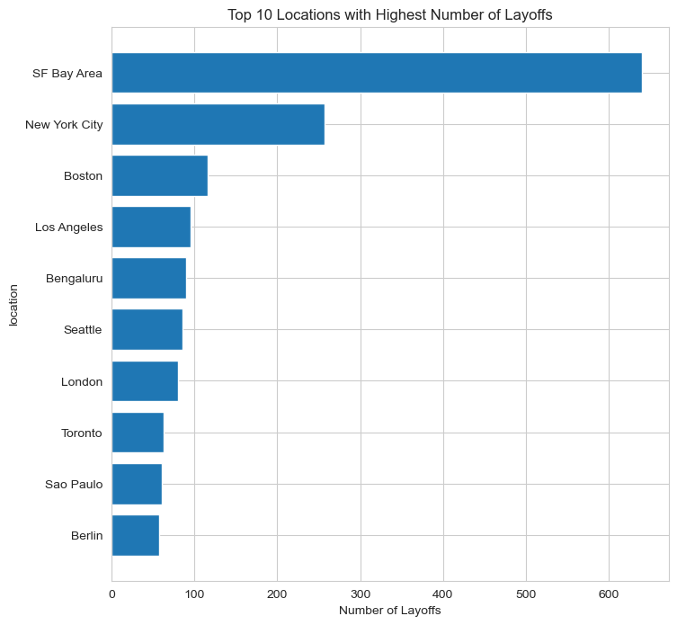
Graph 2

Slide 7
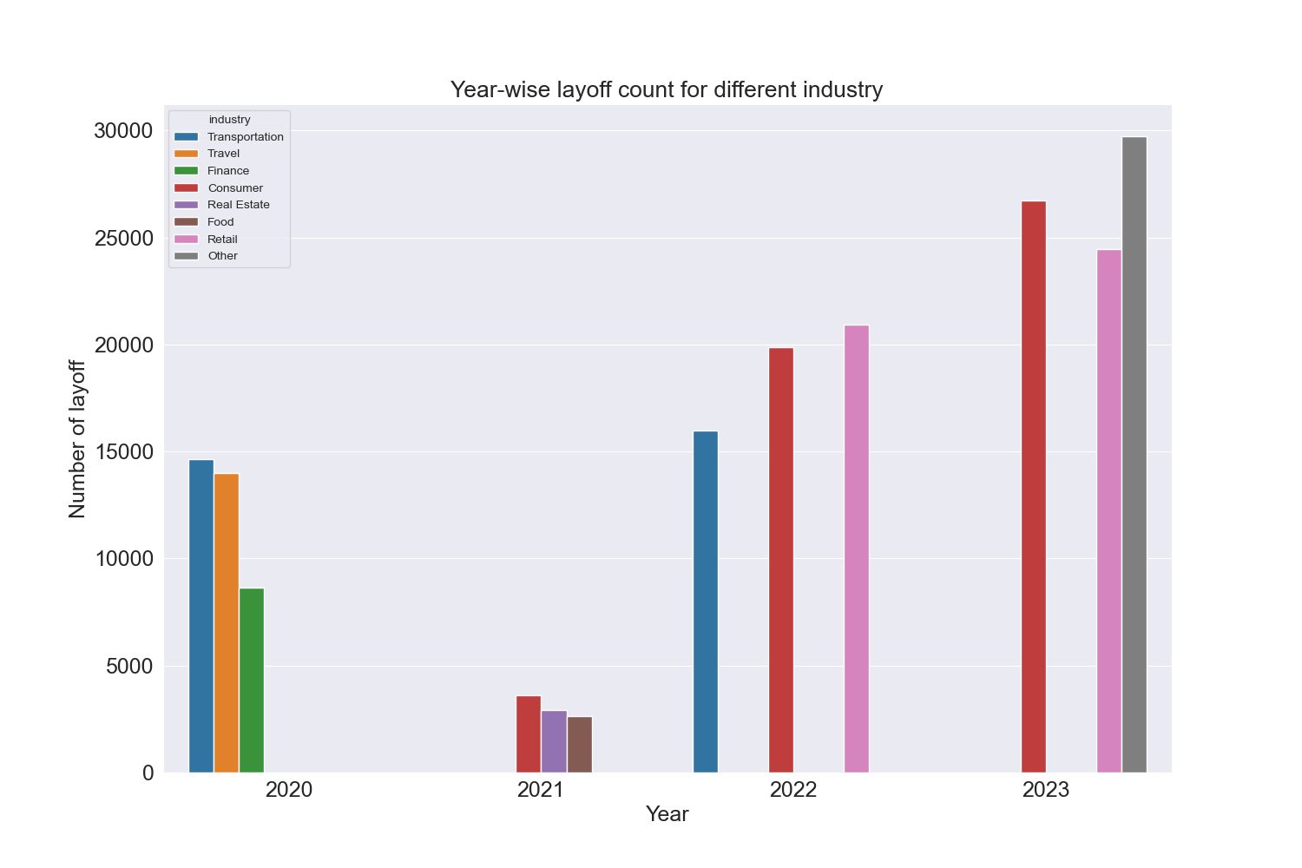
Graph 3

Slide 8
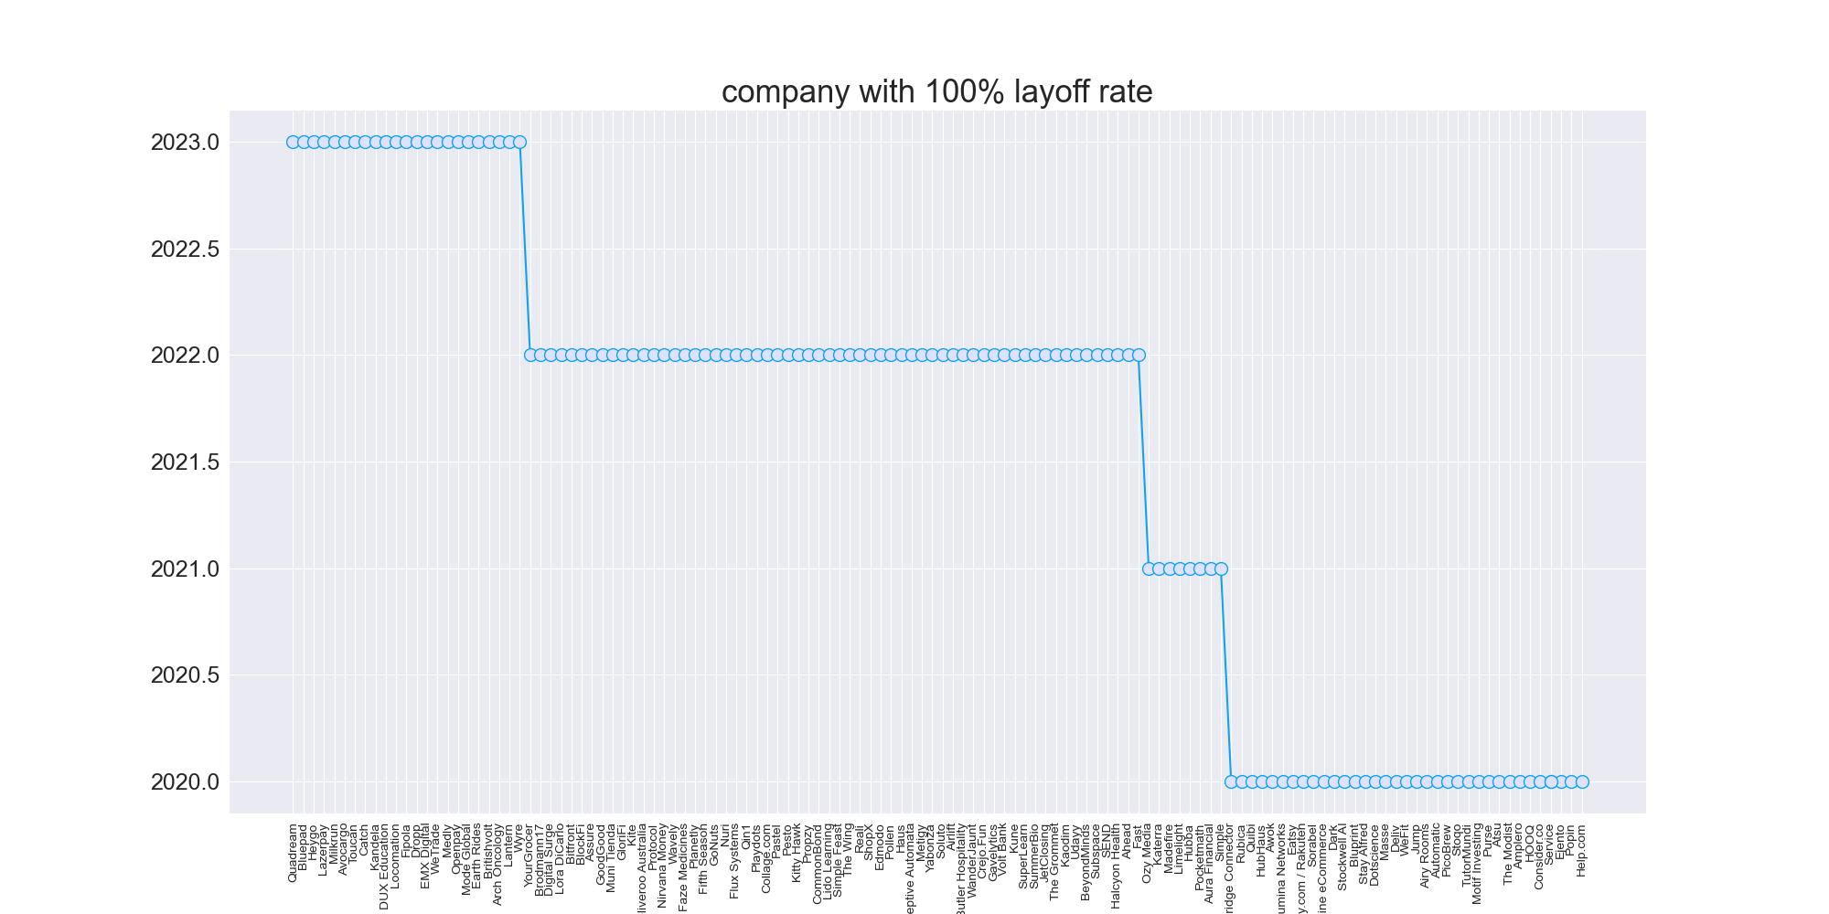

Graph 4

Slide 9
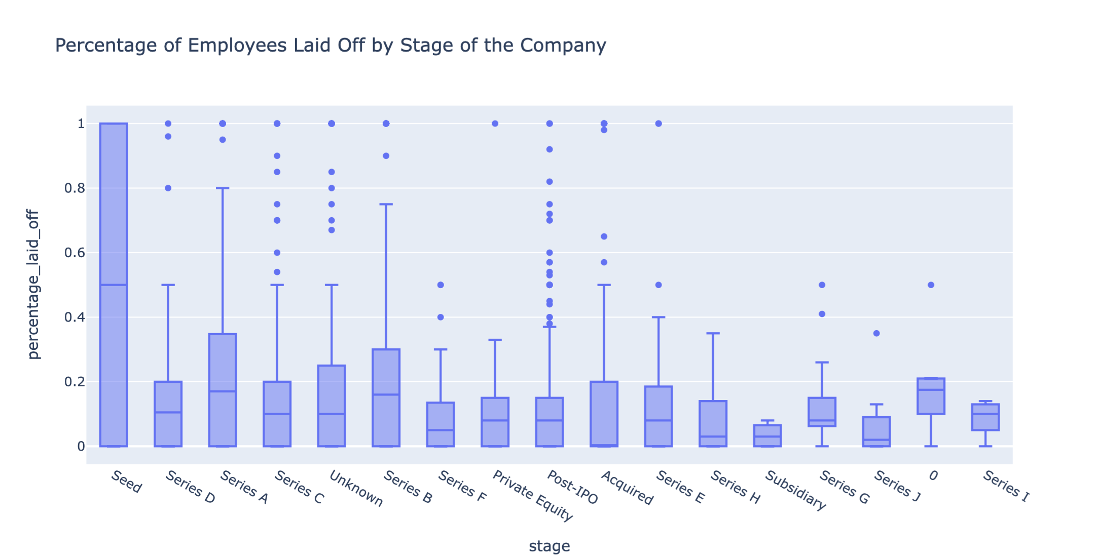
Graph 5

Slide 10
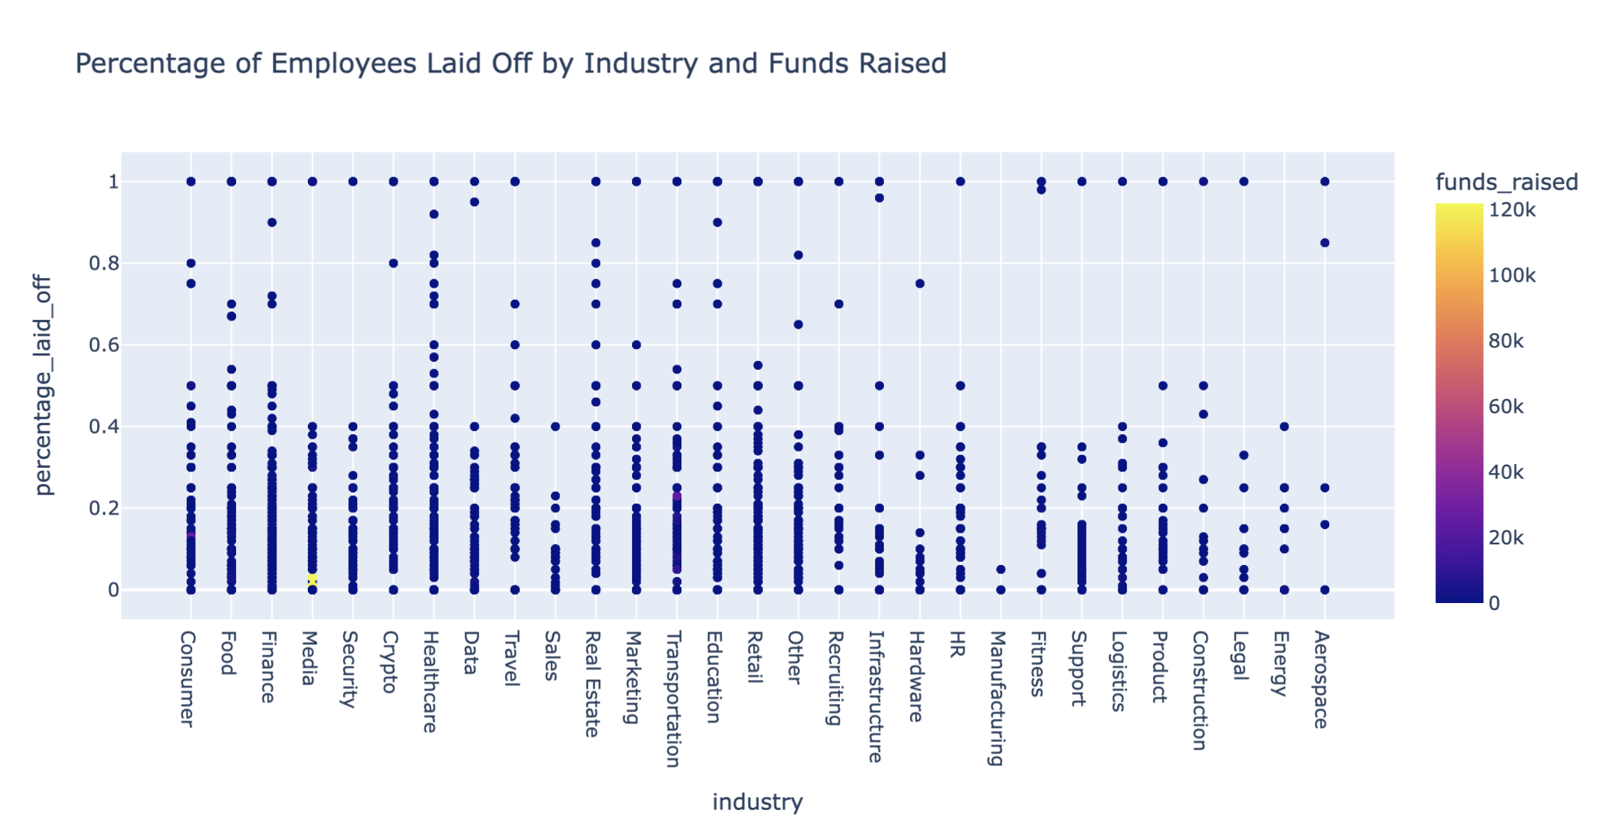
Graph 6

Slide 11
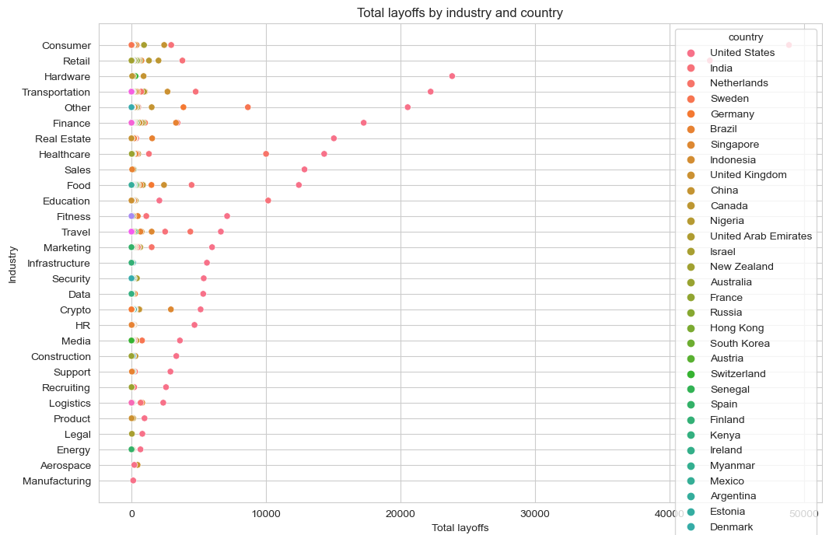
Graph 7

Slide 12
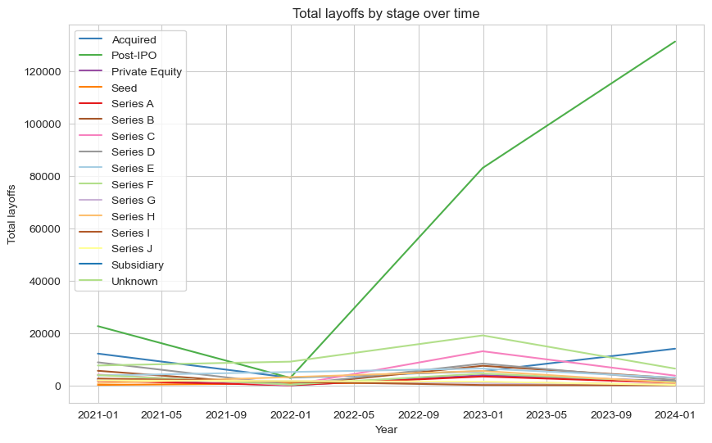
Graph 8

Slide 13
Conclusion
The COVID-19 pandemic had a significant impact on employment, with many industries experiencing mass layoffs
The consumer and retail industries were among the hardest hit, with large numbers of layoffs occurring in countries heavily reliant on these sectors.
The impact of the pandemic on layoffs varied by region, with some areas experiencing more severe job losses than others
The stage of the business cycle, such as the startup phase, may not have played a role in determining the likelihood of layoffs.

Slide 14


